Slide 1
Chapter 6: CPU Scheduling

Slide 2
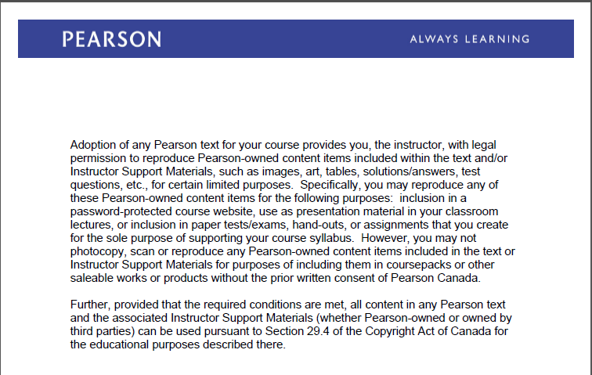
Text Book Slides – Copy Right

Slide 3
Chapter 6: CPU Scheduling
Basic Concepts
Scheduling Criteria
Scheduling Algorithms
Thread Scheduling
Multiple-Processor Scheduling
Real-Time CPU Scheduling
Operating Systems Scheduling Examples

Slide 4
CPU Scheduler
CPU scheduler (also known as short-term scheduler) is a program that selects from the ready queue, based on scheduling algorithms, a process or a thread that should be executed next and allocates the CPU to selected process/thread
Processes and Threads can be described as either:
I/O-bound process/thread – spends more time doing I/O than computations, many short CPU bursts. E.g. sorting, indexing, grouping, import/export data and data transformation
CPU-bound process/thread – spends more time doing computations; few very long CPU bursts. e,.g data classification, complex text mining, natural language processing
Notes:
Reference :Text book chapter 4 page 79 and 80

Slide 5
CPU and I/O Bursts
…
load val
inc val
read file
Threads can be described as either:
I/O-bound – spends more time doing I/O than computations, many short CPU bursts
CPU-bound – spends more time doing computations; few very long CPU bursts
CPU burst
wait for I/O
I/O burst
inc count
add data, val
write file
CPU burst
wait for I/O
I/O burst
load val
inc val
read from file
CPU burst
wait for I/O
I/O burst
…

Slide 6
Process Scheduling
Maximize CPU use, quickly switch processes onto CPU for time sharing
Maintains scheduling queues of processes
Job queue – set of all processes in the system
Ready queue – set of all processes residing in main memory, ready and waiting to execute
Device queues – set of processes waiting for an I/O device
Processes can migrate among the various queues
https://www.youtube.com/watch?v=THqcAa1bbFU

Slide 7
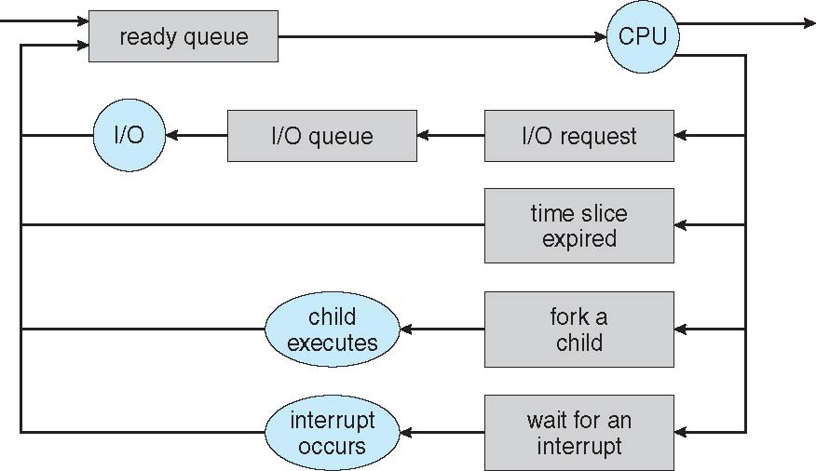
Representation of Process Scheduling

Slide 8
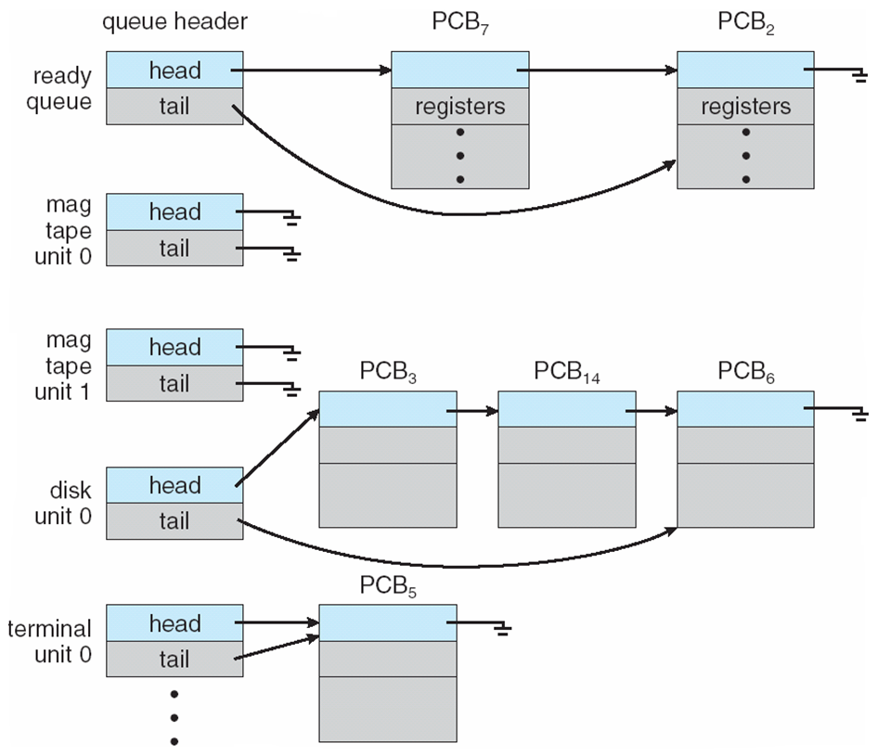
Ready Queue And Various I/O Device Queues

Slide 9
Scheduling strategies
Non-preemptive
Once a process is in the running state, it will continue until it terminates or blocks itself for I/O
Preemptive
Currently running process may be interrupted and moved to the Ready state by the operating system
Allows for better service since any one process cannot monopolize the processor for very long
Notes:
Linux processes are preemptive. If a process enters the TASK_RUNNING state, the kernel checks whether its dynamic priority is greater than the priority of the currently running process.If it is, the execution of current is interrupted and the scheduler in invoked to select another process to run.
A process also can be preemptive when its time quantum expires.
Linux kernel is nonpreemptive .

Slide 10
CPU Scheduler
CPU scheduler is the program that CPU scheduling decisions may take place when a process:
1. Switches from running to waiting state
2. Switches from running to ready state
3. Switches from waiting to ready
4. Terminates
Scheduling under 1 and 4 is nonpreemptive
All other scheduling is preemptive

Slide 11
Scheduling Criteria
CPU utilization – keep the CPU as busy as possible
Throughput – Number of processes that complete their execution per time unit
Turnaround time – amount of time to execute a particular process
Waiting time – amount of time a process has been waiting in the ready queue
Response time – amount of time it takes from when a request was submitted until the first response is produced.
Ensure fairness for all jobs
Notes:
Many criteria have been suggested for comparing CPU –Scheduling algorithms . This criteria make difference in the determination of the best algorithm.
We want to maximize CPU utilization and throughput and to minimize Turnaround time, Waiting time and Response time and give everyone and equal amount of CPU and I/O time to be fair . In most the cases we optimize the average measure. Some times with reasonable and predictable response time may be considered more desirable than a system that is faster on the average , but is highly variable.
Reference: Text book page 85

Slide 12
Process Scheduling Algorithms
FCFS (First-Come, First- Served)
SJF (Shortest Job First)
Priority
Round Robin
Multi-level Queues
https://www.youtube.com/watch?v=2IvSHtBOsEo

Slide 13
First-Come, First-Served
A short process may have to wait a very long time before it can execute
Easy to implement
Ignores service time
Favors CPU-bound processes
I/O processes have to wait until CPU-bound process completes
Notes:
FCFS is nonpreemptive scheduling. When running the running process blocks, the first process on the queue is run next.When blocked process becomes ready, it is put at the end of the queue. With this algorithm a single linked list keeps track of all ready processes.
FCFS performs better for long processes( batch systems).
FCFS is often combined with other algorithms to provide effective scheduler
Text book page 86 and 87

Slide 14
First-Come, First-Served (FCFS) Scheduling
Process Burst (CPU) Time (ms)
P₁ 24
P₂ 3
P₃ 3
Suppose that the processes arrive in the order: P₁ , P₂ , P₃ The Gantt Chart for the schedule is:
Turnaround Time for P₁ = 24, P₂ = 27; P₃ = 30 ms
Average Turnaround Time = (24 +27+30) /3 = 27 ms
Waiting time for P₁ = 0; P₂ = 24; P₃ = 27 ms
Average waiting time: (0 + 24 + 27)/3 = 17 ms
P₁
P₂
P₃
0
24
27
30

Slide 15
Quantum
A quantum is the amount of time a process or thread gets to run before Windows checks to see whether another thread at the same priority is waiting to run. If a thread completes its quantum and there are no other threads at its priority, Windows permits the thread to run for another quantum.
“Quantum value depends on operating systems and CPU architecture. e.g Windows client operating systems, threads run by default for 2 clock intervals; on Windows Server systems, by default, a thread runs for 12 clock intervals. The rationale for the longer default value on server systems is to minimize context switching. By having a longer quantum, server applications that wake up as the result of a client request have a better chance of completing the request and going back into a wait state before their quantum ends” -Windows Internals Part 1

Slide 16
Shorter quantum yields more context switches
Thread execution time: 15
context switches
quantum
20
0
0
15
10
1
0
10
15
1
14
0
10
15

Slide 17
Round Robin (RR)
Preemptive algorithm.
It is one of the most widely used algorithms
Clock interrupt is generated at periodic intervals, when an interrupt occurs, the currently running process is placed in the ready queue
The time assigned to the process is known as time slicing (Quantum). Each process gets a small unit of CPU time (time quantum q), usually 10-100 milliseconds. After this time has elapsed, the process is preempted and added to the end of the ready queue.
If there are n processes in the ready queue and the time quantum is q, then each process gets 1/n of the CPU time in chunks of at most q time units at once.
Timer interrupts every quantum to schedule next process
Performance
large quantum ⇒ FIFO
small quantum ⇒ too many context switch, overhead is too high

Slide 18
Example of RR with Time Quantum = 4ms
Process Burst Time(ms)
P₁ 24
P₂ 3
P₃ 3
Quantum =4ms
Turnaround Time for P₁ = 30, P₂ = 7; P₃ = 10 ms
Average Turnaround Time = (30 +7+10) /3 = 15.666ms
Waiting time for P₁ = 6; P₂ = 4; P₃ = 7 ms
Average waiting time: (6 + 4 + 7)/3 = 5.666ms
P₁
P₂
P₃
P₁
P₁
P₁
P₁
P₁
0
4
7
10
14
18
22
26
30

Slide 19
Round -Robin
Process Arrival Time(ms) CPU Time (ms)
P₁ 0.0 7
P₂ 2.0 4
P₃ 4.0 1
P₄ 5.0 4
Average waiting time : (9+5+0+4)/4 = 4.5ms
Average turnaround time : (( 16-0)+(11-2)+( 5-4)+(13-5))/4 = 8.5 ms
Quantum = 2ms
P₁
P₂
P₃
P₄
P₁
P₂
P₄
P₁
P₁
0
2
4
5
7
9
11
13
15
16
Notes:
This example (RR) represents execution of 4 process with same arrival and CPU cycle as SJN and quantum 2 msec.
P1 waited between 2 and 7 and between 9 and 13 that is 5 +4=9 msec
P1 finished at 16 minus arrival time 0 = 16msec
P2 waited between 4 and 9 that is 5 msec
P2 finished at 11 minus arrival time 2 = 9 msec.
More examples Text book pages 92 and 93

Slide 20
Priority Scheduling
Preemptive and Non-Preemptive Algorithm
A priority number (integer) is associated with each process
Scheduler will always choose a process of higher priority over one of lower priority
Have multiple ready queues to represent each level of priority
The CPU is allocated to the process with the highest priority
(In Linux - smallest integer ≡ highest priority)
Problem ≡ Starvation – low priority processes may never execute
Solution ≡ Aging – as time progresses increase the priority of the process

Slide 21
Example of Priority Scheduling
ProcessA Burst(CPU)Time(ms)T Priority
P₁ 10 3
P₂ 1 1
P₃ 2 4
P₄ 1 5
P₅ 5 2
Priority scheduling Gantt Chart
Average Turnaround Time = (16+1+18+19+6 )/5= 12ms
Average waiting time = 8.2 ms
P₂
P₅
P₁
P₃
P₄
0
1
6
16
18
19

Slide 22
CPU Scheduling Algorithms
https://www.youtube.com/watch?v=1ikcIKDGEz4

Slide 23
Multilevel Queue
Ready queue is partitioned into separate queues, eg:
foreground (interactive)
background (batch)
Each queue has its own scheduling algorithm:
foreground – RR
background – FCFS
Scheduling must be done between the queues:
Fixed priority scheduling; (i.e., serve all from foreground then from background). Possibility of starvation.
Time slice – each queue gets a certain amount of CPU time which it can schedule amongst its processes; i.e., 80% to foreground in RR
20% to background in FCFS

Slide 24
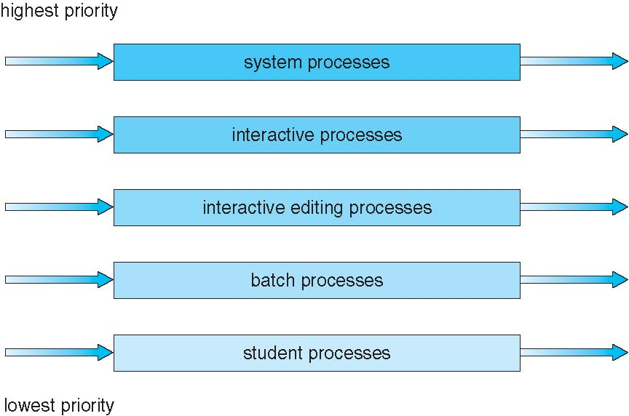
Multilevel Queue Scheduling

Slide 25
Multilevel Feedback Queue
A process can move between the various queues; aging can be implemented this way
Multilevel-feedback-queue scheduler defined by the following parameters:
number of queues
scheduling algorithms for each queue
method used to determine when to upgrade a process
method used to determine when to demote a process
method used to determine which queue a process will enter when that process needs service

Slide 26
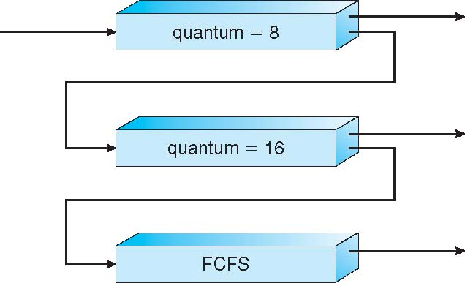
Example of Multilevel Feedback Queue
Three queues:
Q₀ – RR with time quantum 8 milliseconds
Q₁ – RR time quantum 16 milliseconds
Q₂ – FCFS
Scheduling
A new job enters queue Q₀ which is served FCFS
When it gains CPU, job receives 8 milliseconds
If it does not finish in 8 milliseconds, job is moved to queue Q₁
At Q₁ job is again served FCFS and receives 16 additional milliseconds
If it still does not complete, it is preempted and moved to queue Q₂

Slide 27
Windows Processes and Threads
Access Token (Security )
Process
Object
VAD
VAD
VAD
Virtual Address Space Descriptors
Handle Table
object
object
Thread
Thread
Thread
. . .
Access Token
Notes:
In addition to a private address space and one or more threads, each process has a security identification and a list of open handles to objects such as files, shared memory sections, or one of the synchronization objects such as mutexes, events, or semaphores, as illustrated in this slide. Every process has a security context that is stored in an object called an access token. The process access token contains the security identification and credentials for the process. By default, threads don’t have their own access token, but they can obtain one, thus allowing individual threads to impersonate the security context of another process—including processes running on a remote Windows system—without affecting other threads in the process. (See Chapter 8 for more details on process and thread security.) The virtual address descriptors (VADs) are data structures that the memory manager uses to keep track of the virtual addresses the process is using. These data structures are described in more depth in the Memory Management unit (Book Chapter 7).

Slide 28
Windows Process Control Block (PCB)
Process ID (PID)
Windows implementation of PCB is split in multiple data structures
Parent PID
…
Next Process Block
PCB
List of open files
Handle Table
Image File Name
Thread Control Block (TCB)
List of Thread Control Blocks
Next TCB
…
Program Counter
Registers
…

Slide 29
DLLs (Dynamic Linked Libraries)
A Dynamic Link Library (DLL) is a Windows module that contains functions (code) and data.
What is DLL? https://support.microsoft.com/en-us/kb/815065
DLLs help reduce memory overhead when several applications use the same functionality at the same time, because although each application receives its own copy of the DLL data, the applications share the DLL code.
In the body of the function, you may handle any combination of the following scenarios in which the DLL entry point has been called:
A process loads the DLL (DLL_PROCESS_ATTACH).
The current process creates a new thread (DLL_THREAD_ATTACH).
A thread exits normally (DLL_THREAD_DETACH).
A process unloads the DLL (DLL_PROCESS_DETACH).

Slide 30
DLLs (Dynamic Linked Libraries)
Many Windows functions allow programmers to import linked functions such as Loadlibrary and GetprocAddress that allow a program to access any function in any library on the system.
When a program calls linked library function, the function executes within the library. Functions called and libraries used are important part of a process because tell us what a program does and helps to identify which functions are being linked to by a suspect program.

Slide 31
Windows DLL
Windows DLL e.g.
Kernel32.dll It contains core functionality such as access and manipulation of memory, files and hardware
Advapi32.dll Allows access to Service Manager and Registry
User32.dll It contains user interface components such as buttons, scroll bars, etc
Gdi32.dll It contains functions to display and manage graphics
Every DLL contains (imports) functions e.g kernel32.dll includes CreateThread, GetCurrentProcess, Openprocess, GetProcessHeap and many more . It is important to get familiar with these functions to analyze and detect malicious software (malware analysis) . You can find details about DLL at Microsoft MSDN web site: https://msdn.microsoft.com/en-us/library/31d242h4%28v=vs.110%29.aspx

Slide 32
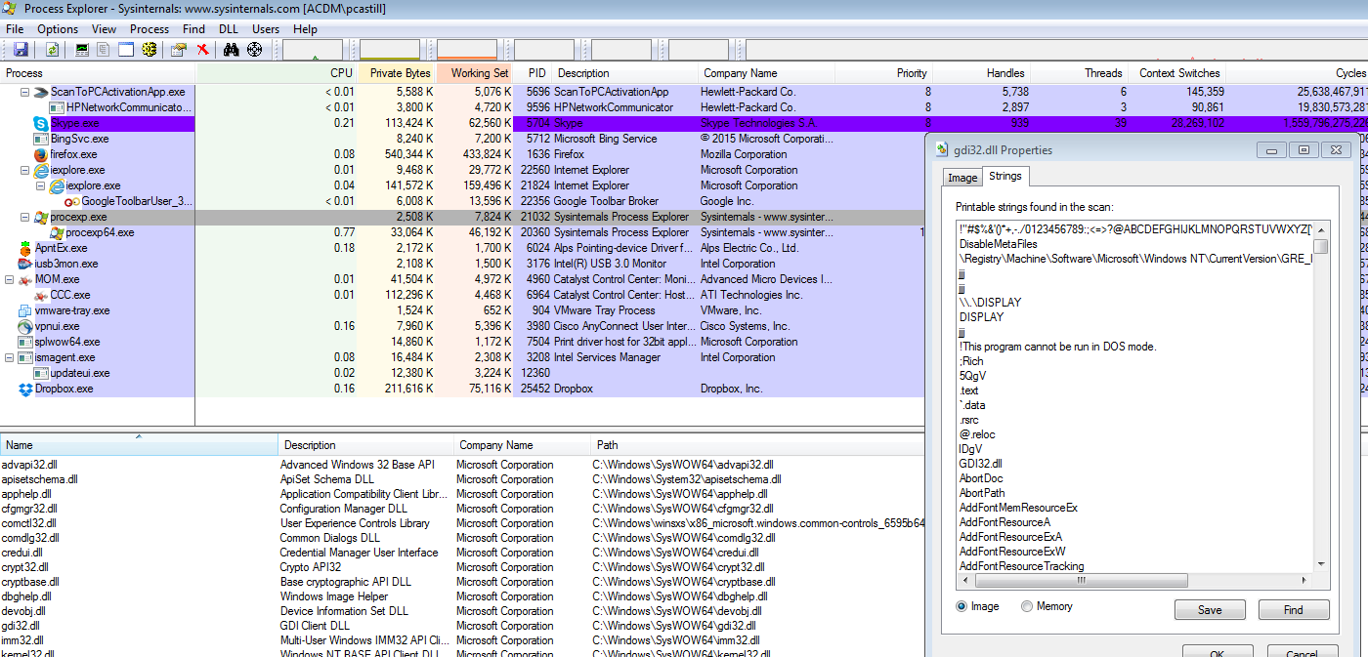
System Internals -Process Explorer
System Internals Tools such as Process Explorer and Process Monitor can be used to display DLLs used by processes

Slide 33
Windows Process and Thread
Data Structures for each process/thread:
Executive process block (EPROCESS)
Executive thread block (ETHREAD)
Win32 process block
Process environment block
Thread environment block
Process environment block
Thread environment block
Process address space
System address space
Process block
(EPROCESS)
Win32 process block
Handle table
Thread block
(ETHREAD)
...
Notes:
Each Windows process is represented by an executive process (EPROCESS) block. Besides containing many attributes relating to a process, an EPROCESS block contains and points to a number of other related data structures. For example, each process has one or more threads represented by executive thread (ETHREAD) blocks. (Thread data structures are explained in the section “Thread Internals” later in this chapter.) The EPROCESS block and its related data structures exist in system space, with the exception of the process environment block (PEB), which exists in the process address space (because it contains information that is modified by user-mode code).
In addition to the EPROCESS block, the Windows subsystem process (Csrss) maintains a parallel structure for each Windows process that executes a Windows program. Also, the kernel-mode part of the Windows subsystem (Win32k.sys) has a per-process data structure that is created the first time a thread calls a Windows USER or GDI function that is implemented in kernel mode.

Slide 34
Windows Scheduling
Windows implements a preemptive scheduler. Windows uses priority-based preemptive scheduling. Highest-priority thread runs next. If a thread with a higher priority becomes ready to run, the currently running thread might be preempted before finishing its time slice. In fact, a thread can be selected to run next and be preempted before even beginning its quantum!
Thread runs until
It is done (task is completed)
Blocks for I/O. It enters a wait state
Uses time slice (quantum expires). It yields execution.
The thread is preempted by higher-priority thread
Thread priority changes, either because of a system service call or Windows itself changes the priority value
Thread’s processor affinity changes so it will no longer run on the processor on which it was running

Slide 35
Windows Scheduling
Real-time threads can preempt non-real-time
Windows supports 32-level priority scheme.
Variable class is 1-15, real-time class is 16-31
Priority 0 is memory-management thread
There is a queue for each priority
If no run-able thread, the system runs idle thread
https://msdn.microsoft.com/en-us/library/windows/desktop/ms685100%28v=vs.85%29.aspx

Slide 36
Windows Priority Classes
Win32 API identifies several priority classes to which a process can belong
REALTIME_PRIORITY_CLASS, HIGH_PRIORITY_CLASS, ABOVE_NORMAL_PRIORITY_CLASS,NORMAL_PRIORITY_CLASS, BELOW_NORMAL_PRIORITY_CLASS, IDLE_PRIORITY_CLASS
All are variable except REALTIME
A thread within a given priority class has a relative priority
TIME_CRITICAL, HIGHEST, ABOVE_NORMAL, NORMAL, BELOW_NORMAL, LOWEST, IDLE
Priority class and relative priority combine to give numeric priority
Base priority is NORMAL within the class
If quantum expires, priority lowered, but never below base
If wait occurs, priority boosted depending on what was waited for
Foreground window given 3x priority boost

Slide 37
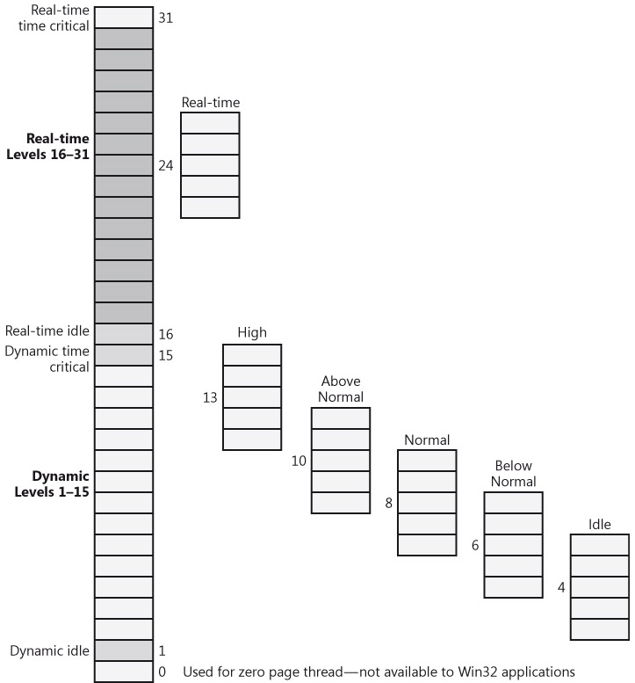
Windows Process Scheduling

Slide 38
Windows Priorities

Slide 39
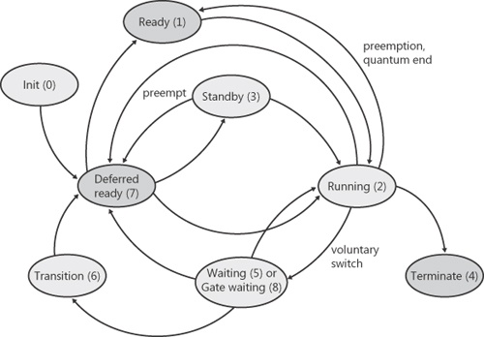
Windows Threads Scheduling

Slide 40
Linux Scheduling in Version 2.6 +
Linux implements Completely Fair Scheduler (CFS)
Scheduling classes
There are two scheduling classes:
default
real-time
Each class has specific priority
Scheduler picks highest priority task in highest scheduling class
Quantum calculated based on nice value from -20 to +19
Lower value is higher priority
CFS scheduler maintains per task virtual run time in variable vruntime
To decide next task to run, scheduler picks task with lowest virtual run time

Slide 41
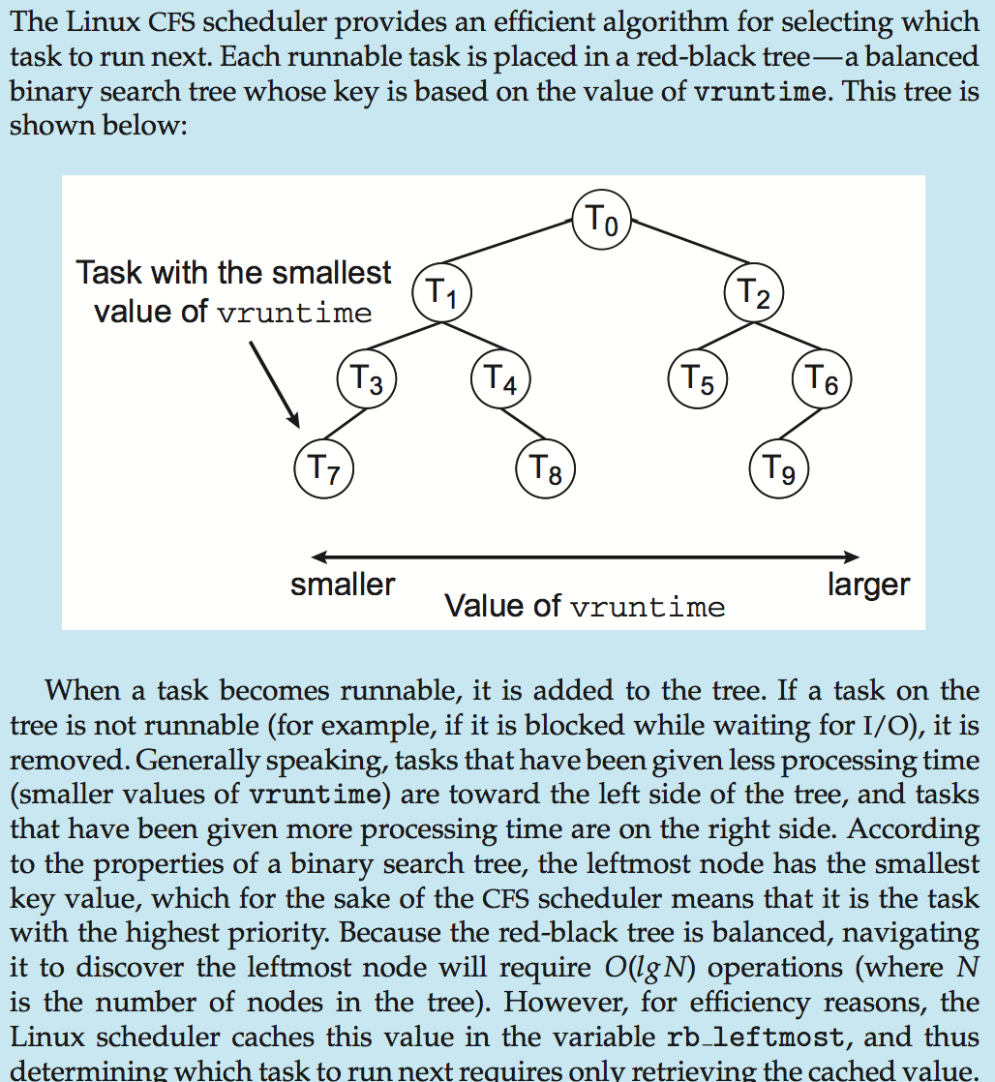
Completely Fair Scheduler (CFS)

Slide 42
Linux Scheduling
Scheduling classes
SCHED_FIFO: Real-time processes. First-in-first-out
algorithm
SCHED_RR: Real-time processes. Round-Robin algorithm
SCHED_OTHER: Default –Time Sharing (TS) processes. It implements priority algorithm
Linux implements the FIFO and Round-Robin real-time scheduling classes; in both cases, each process has a priority in addition to its scheduling class.
Linux chrt command can be used to display scheduling attributes of all tasks for a given PID
Notes:
In Linux each process has a base time quantum value assigned by the scheduler.
The user can change the base time quantum of the processes using nice( ) and setpriority( ) system calls
Linux adopted the rule of thumb to choose the quantum duration: Choose a duration as long as possible , while keeping good system response time.
The Fields related to scheduling included in the process descriptor are:
1. need_resched : A flag to decide whether to invoke the schedule( )
function
2. Policy :SCHED_FIFO: First-in-first-out real-time threads
SCHED_RR: Round-robin real-time threads
SCHED_OTHER: Other, non-real-time threads (time –sharing)
Linux called real time threads in conformant to the P1003.4 standard
3. Priority : The base time quantum of the process
4. Counter : The number of ticks of CPU time left to the process before its quantum expires
Reference:Daniel P.Bovet and Marco Cesati, Understanding the Linux.
Kernel

Slide 43
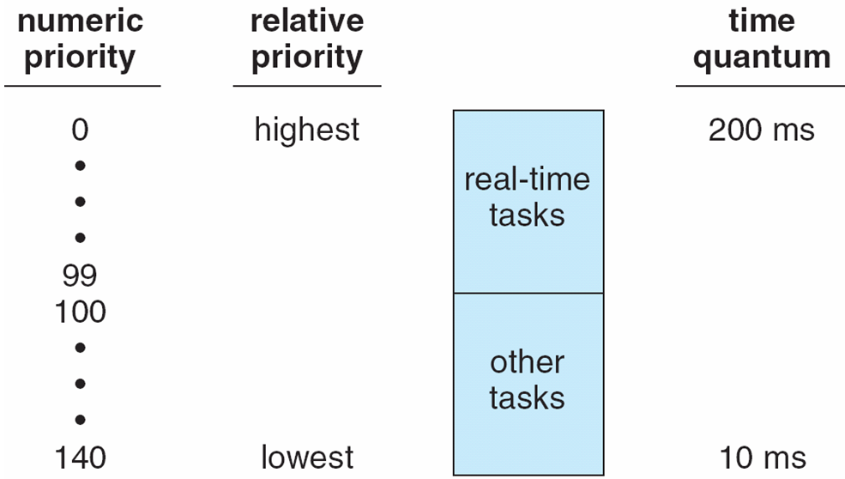
Priorities and Time-slice length

Slide 44
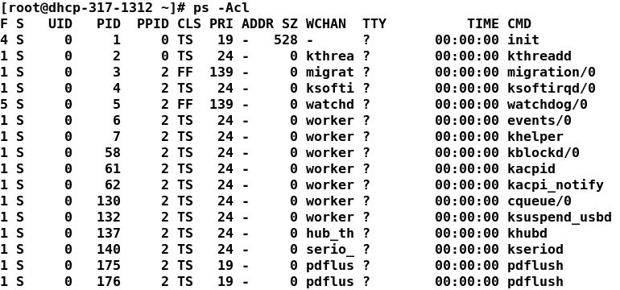
ps –c process scheduling class
This command displays process scheduling class (Policy)
TS - Time sharing SCHED_OTHER
FF - Real Time process FIFO - SCHED_FIFO
RR -Real Time process RR - SCHED_RR

Slide 45
Scheduling Time Sharing (TS) processes
In Linux time sharing processes can be schedule using the nice command
The system uses nice attribute to determine process priority compared to other processes.
Increasing the values of nice decreases process’ priority
Default value of nice = 0
Nice range is -20 > Nice < 19
nice -n -10 ps -increases process ps priority
nice -n 10 ps -decreases process ps priority by 10 units
Only TS processes can be niced
Real Time process CAN NOT be niced

Slide 46
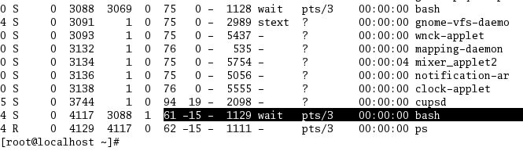
Changing Nice Value
#nice –n-15 bash – This command will
create a new process with high priority

Slide 47
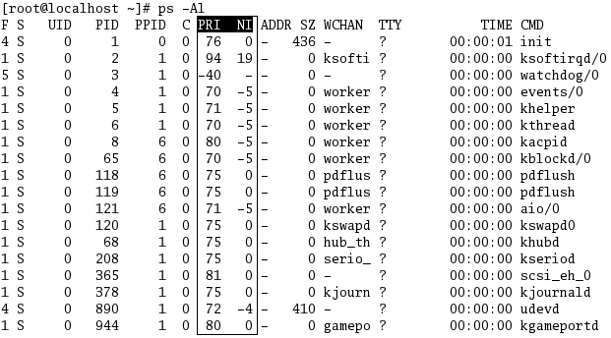
NICE Value

Slide 48
Multiple-Processor Scheduling
CPU scheduling more complex when multiple CPUs are available
Asymmetric multiprocessing – only one processor accesses the system data structures, alleviating the need for data sharing. One CPU manages scheduling , it makes decision on next process to use a specific CPU. This CPU is known as master server, the other CPUs execute only code
Symmetric multiprocessing (SMP) – Each CPU manages its own scheduling. All processes may be in a common ready queue, or each CPU may have its own private queue of ready processes. Each CPU uses its own scheduler to select a process to execute
Currently, most common

Slide 49
Processor Affinity
Processor affinity – It keeps processes running on the same CPU. Process has affinity for processor on which it is currently running. SMP systems avoids migration of processes among CPUs because that causes caches.
Two types of affinity
Soft affinity: OS has a policy to keep processes running on same CPU but there is not guarantee to keep this policy
Hard affinity: OS will specify a subset of CPUs on which processes may run
Linux supports both

Slide 50
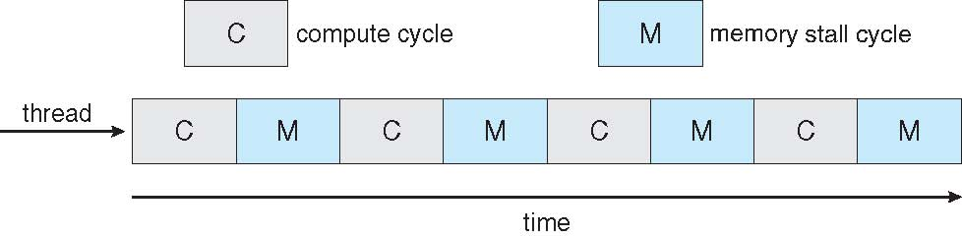

Multithreaded Multicore System

Slide 51
Virtualization and Scheduling
Virtualization software schedules multiple guests onto CPU(s)
Each guest doing its own scheduling
Not knowing it does not own the CPUs
Can result in poor response time
Can effect time-of-day clocks in guests
Can undo good scheduling algorithm efforts of guests

Slide 52
References
Silberschatz, Galvin and Gagne, Operating System Concepts with Java, John Wiley & Sons, latest edition.
Chapter 6 – Process Scheduling

Slide 53
End of Chapter 6

